Slide 1
DEEP UPDATE
Presented by: Ivonne Hall, P.E., Assistant Director
Carlos A. Esguerra, Supervising Environmental Engineer
Stacy Pappano, Supervising Environmental Engineer
Bureau of Water Protection and Land Reuse
Water Planning and Management Division
CT WEA FALL WORKSHOP
October 16, 2023

Slide 2
Agenda
Staff Update
Clean Water Fund Update
Fats, Oils, & Grease (FOG) Update
Permit expires 2025
Consultant
Lessons learned from regulated community
Pump Station Survey Findings
PFAS Report Summary
Nitrogen General Permit Update
Renewal Changes
Cost of Credit
Nitrogen Loading
O & M Survey
NPDES Permit – Phosphorus Loading Calculation
Operator Certification
Notes:
I will start us out discussing staff and the Clean Water Fund Priority List
I will be followed by Carlos Esguerra, who will discuss Fats Oils & Grease, Pump Station survey
Then Stacy Pappano is our closer, and she will talk about PFAS, nitrogen and phosphorus and operator certification

Slide 3
Ivonne Hall, Assistant Director
Notes:
I started my DEEP career in this group where I worked as a project engineer for 10 years, then I took a job in Dam Safety as supervisor for 4 years.
Last year, I had the opportunity to come back home as AD.

Slide 4
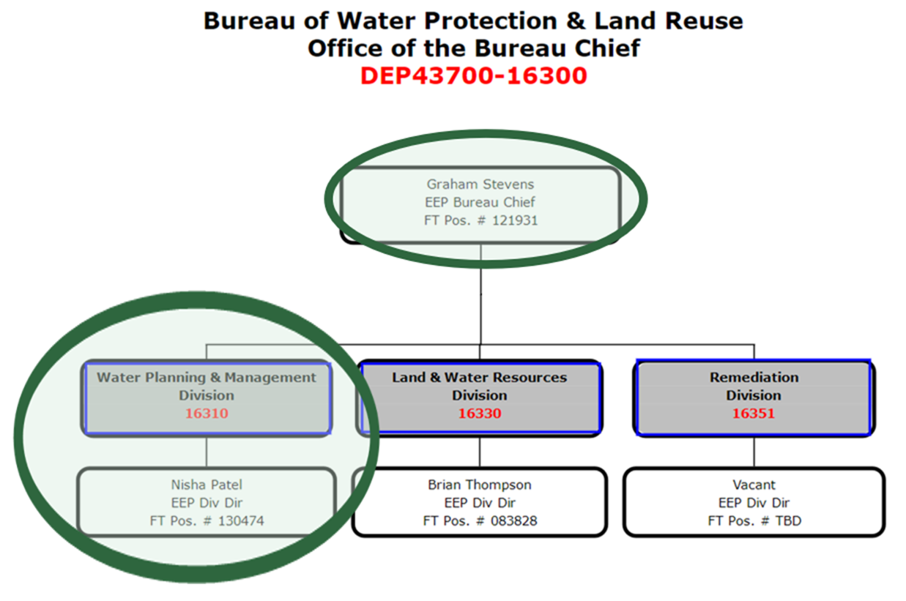
DEEP Municipal Wastewater org chart
Replaced Betsey Wingfield
Replaced Jen Perry, who had replaced Denise Ruzicka
Notes:
Lots of retirements within the past few years, people shifting roles
Refresher about the organizational structure for muni ww
Graham replaced Betsey Wingfield, Nisha replaced Jennifer Perry who had replaced Denise Ruzicka: Nisha stand up

Slide 5
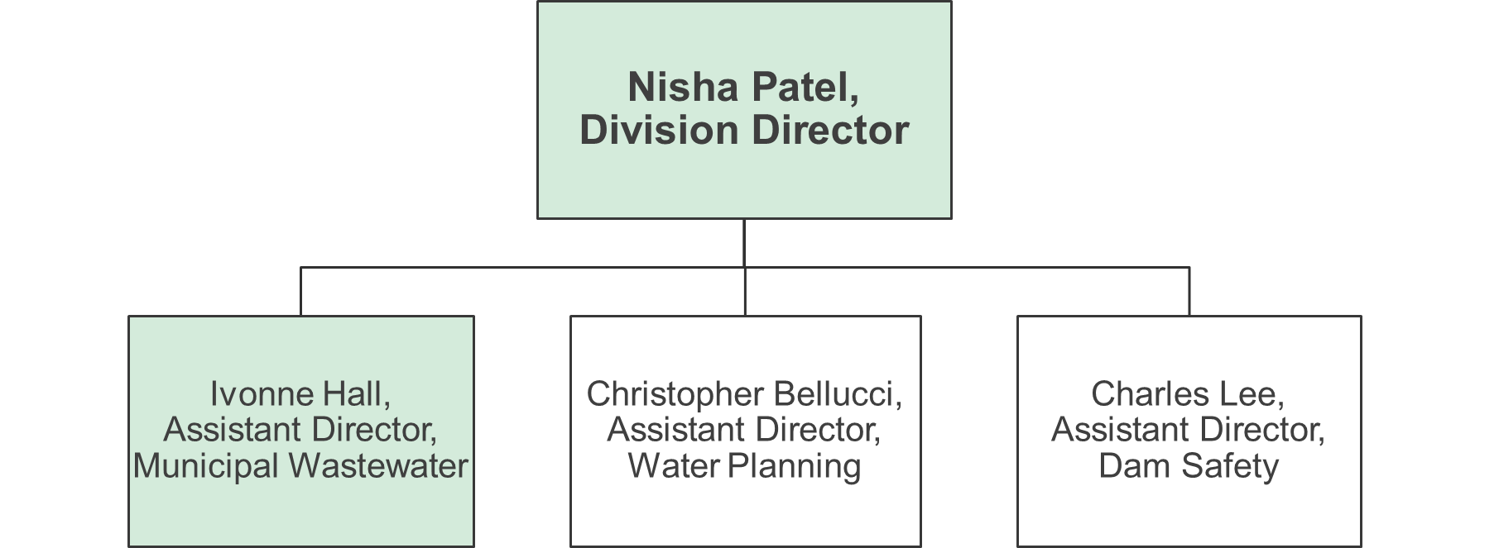
Deep - water planning & management division
Replaced Nisha Patel who is now Director
Notes:
I replaced Nisha as AD

Slide 6
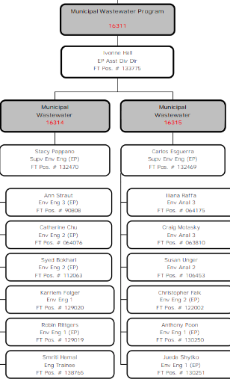
Municipal wastewater
New supervisors in 2022
Carlos Esguerra & Stacy Pappano
Replaced George Hicks & Rowland Denny who both retired
New staff engineers in 2022
Anthony Poon
Jueda Shytko
Karriem Kazu Folger
Robin Rittgers
Newest staff engineer in 2023
Smriti Hamal
Notes:
If you can’t read, will be able to reference in slide deck that will be sent out after this meeting
Rest of DEEP staff stand up: we are mostly all here with the exception of Ann Straut, our senior engineer; and our inspectors Craig Motasky and Susan Unger or Lex
We are continuing our UConn streak: our newest engineer is Smriti Hamal

Slide 7
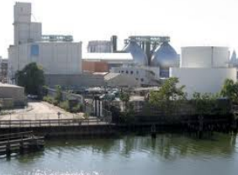
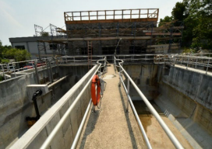
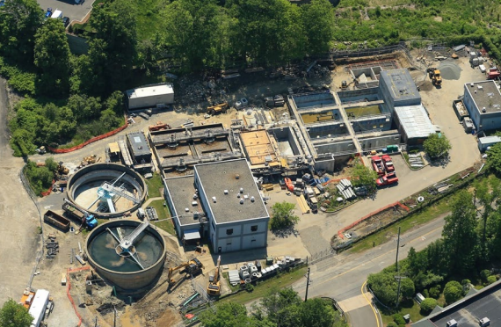
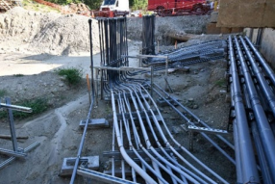
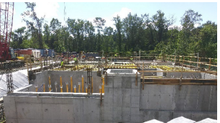
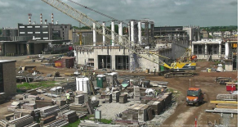
CT DEEP Clean Water Fund
The Clean Water Fund is the primary funding program for municipal wastewater projects in CT.
Combined Sewer Overflow (CSO) Control
Nutrient removal (N & P) at treatment plants
Sewer extensions for pollution problems
Large scale septic system upgrades
Pump station upgrades
Resiliency projects (sea level rise)
Green infrastructure
Examples of CWF projects:
Can be used for planning, design, and construction phases.
Infiltration and Inflow removal (pipe rehabilitation)
Established in 1987.
Notes:
Clean Water Fund is the primary funding program for municipal wastewater projects, started in 1987 to replace EPA Construction Grants Program
Funds sewage treatment plants, pipes and pumps
CT CWF serves as model for other programs in the US

Slide 8
CWF Program Funding (grant percentages)
Planning 55%
CSO Control 50%
Nutrient (N & P) removal 30%
Small Community 25%
Other 20%
Collection System 0% or 20%
Loans at 2% per year for 20 years for eligible costs
Notes:
Grant percentages prescribed by statute
All but the planning projects receive the remainder of the eligible project costs as loan

Slide 9
CWF Sources of money
EPA grants
State
State Revenue Bonds (loans)
Base Capitalization grant
BIL Supplemental grant
Stormwater & Sewer Overflow grant or OSG
General Obligation Bonds (grants)
BIL Emerging Contaminants
Notes:
Different pots of $ fund the CT CWF but the state investment is larger than federal $ by far, even w/passage of BIL
Base cap grant keeps shrinking from $17M/year to less than $7M anticipated for FY25 due to earmarks

Slide 10
How do CWF projects get funded?
As a Category I, II or III project
Priority points
Reserve
Notes:
Priority List has 3 mechanisms for funding projects, and I will walk you through each mechanism

Slide 11
Categories
Categories
Category I
CWF application for construction to DEEP during previous funding period
Project was fundable on the previous priority list
CWF agreement has not been executed yet
Category II
Portion of a construction project has been CWF funded
Project is not usable or severely restricted in use until project is completed
Category III
Project will remedy documented pollution of a drinking water supply
Notes:
If you have already submitted a project application for your project and it was shown to be a fundable project under the existing PL, this project is being considered a Cat I project, goes to front of the line ahead of the highest scored projects

Slide 12
Regulatory Priority Point System construction projects
Highest number of points
Meet Water Quality Standards
CSO and Phosphorus Removal
Meet LIS Goal for Nitrogen Removal
Population served
Lower number of points
Failing septic systems
Sewage backups into houses
Eutrophication of watercourses
Notes:
Based on regs: RCSA 22a-482-1(c)
If there are projects that don’t score high but still important priority, there are always reserves

Slide 13
Reserves
First come, first served
Funding not based upon priority points
With few exceptions, available to all towns
Categories change over time (add/delete)
Notes:
Reserves balance the playing field

Slide 14
Reserves
Green & Resiliency reserves
Collection system (pipe or pump station rehab)
Cost increases on existing construction projects
Planning (engineering studies)
Design
Small community (population < 5,000)
Must be fundable project w/in 3 years, and municipality must appropriate full construction costs
Notes:
DEEP’s priorities: Finishing up big nutrient removal projects for nitrogen and phosphorus
Continued focus on CSO removal, also big focus on pipe improvement projects like I/I lining projects
Improving resiliency and preparing for worsening effects of climate change

Slide 15
Developing Draft FY24/25 CWF Priority list
Last May, we asked municipalities to submit project proposals for FY24/25 (thru 6/30/25) in our “Call for Projects”
CT DEEP received $2.4B in proposed projects, and each project was evaluated for readiness
Projects that haven’t started planning are not being considered for this 2-year funding cycle
~$900M in projects determined to be potentially viable projects
Improved consistency with nitrogen points with this round of scoring
Post-COVID, CWF projects pace is quickening
If you have a project that was shown to be fundable on the FY22/23 Priority List but you haven’t moved forward, do not assume it will be fundable again
Notes:
Stricter with nitrogen points this time around
If planning not started, confident it won’t be ready for construction by end of 6/25
Talk to your project engineer

Slide 16
Next steps
Call for projects
Assess readiness to proceed to construction
Determine fundable projects with consideration of available funds (State Capital Budget, EPA grants)
Public notice of public hearing
Public hearing at DEEP
Prepare hearing examiner’s report
DEEP approval
$2.4B in needs submitted
Finalizing draft
$900M+ in needs assessed as ready projects
Prepare draft PL document
Anticipated later this fall
Will be virtual again
Notes:
Hand it off to Carlos

Slide 17
Carlos Esguerra, Supervising Environmental Engineer

Slide 18
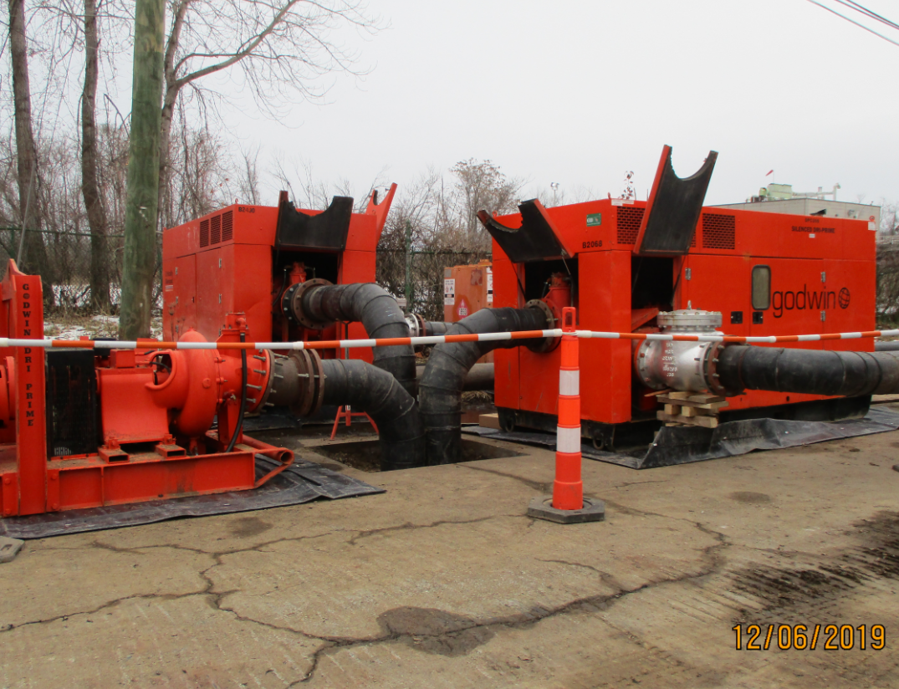
emergency support function # 12 & pump station inventory
CT State Response Framework (SRF) creates an integrated and coordinated framework to manage emergencies in the State of Connecticut.
Emergency Support Function (ESF)#12: addresses significant disruptions in communications, cable and video services, water (including wastewater) and energy supplies for any reason, whether caused by physical disruption of energy transmission and distribution systems, or unexpected operational failure of such systems
Pump station inventory: DEEP updated its inventory of wastewater pump stations (critical infrastructure) with the goal of improving preparedness and facilitating extreme weather event response efforts.
Notes:
-Emergency planning document to prepare systematically, and across all levels of government for incidents or extreme weather situations. This is activated by the SEOC.
-Enhanced and In Advance Coordination between Water/Wastewater and Electric Sector . Priority assets are pre‐identified to the extent possible, or identified at the time of the emergency as needed.
(Department of Emergency Services and Public Protection (DESPP) :
There are 15 ESF ranging from transportation , fire fighting , search and rescue including ESF 12

Slide 19
Pump Station survey emergency support function # 12 CONTACT PERSON: ROBIN.RITTGERS@CT.GOV
SURVEY RESULTS
115 responses out of 132 (87%RR)
1008 pump stations reported
796 with standby generators
Collected utility information (Billing and service account information)
Flood Plain Designation
500y only | 100y
X | VE | AE | A | AO
199 | 14 | 215 | 56 | 2
Notes:
The goal of this effort was two-fold: first create a database that can be helpful during EOC/ESF12 activations, and two: get a baseline of where communities stand with pump station needs. We tried to reduce number of questions to incentivize a higher response rate.
We requested billing account and service account numbers.

Slide 20
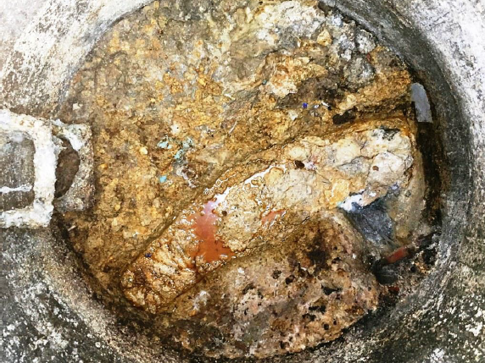
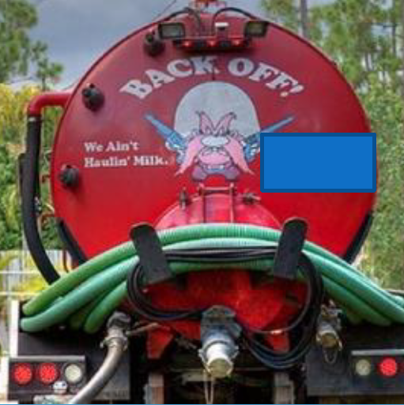
FOG update
Current general permit expires in October 2025 (Issued in 2015)
FOG management is key element of CMOM to prevent SSOs.
DEEP expected to retain engineering consulting services to perform outreach and solicit feedback from communities and restaurants to improve next GP.
Contact Person: Iliana Raffa at Iliana.Raffa@ct.gov
Notes:
Stay tuned for updates. Expiration is about 2 years away, but we want to get an early start.- This is a topic that will be ramping up in the next several months

Slide 21
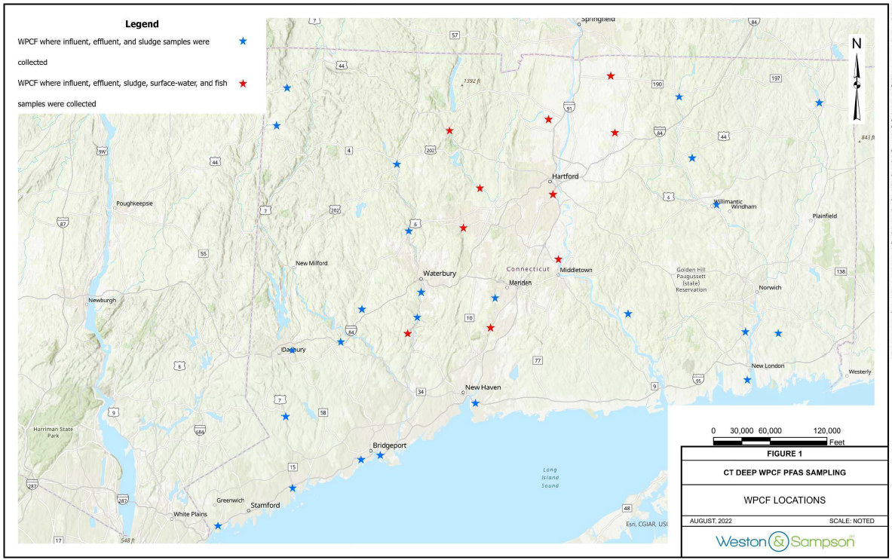
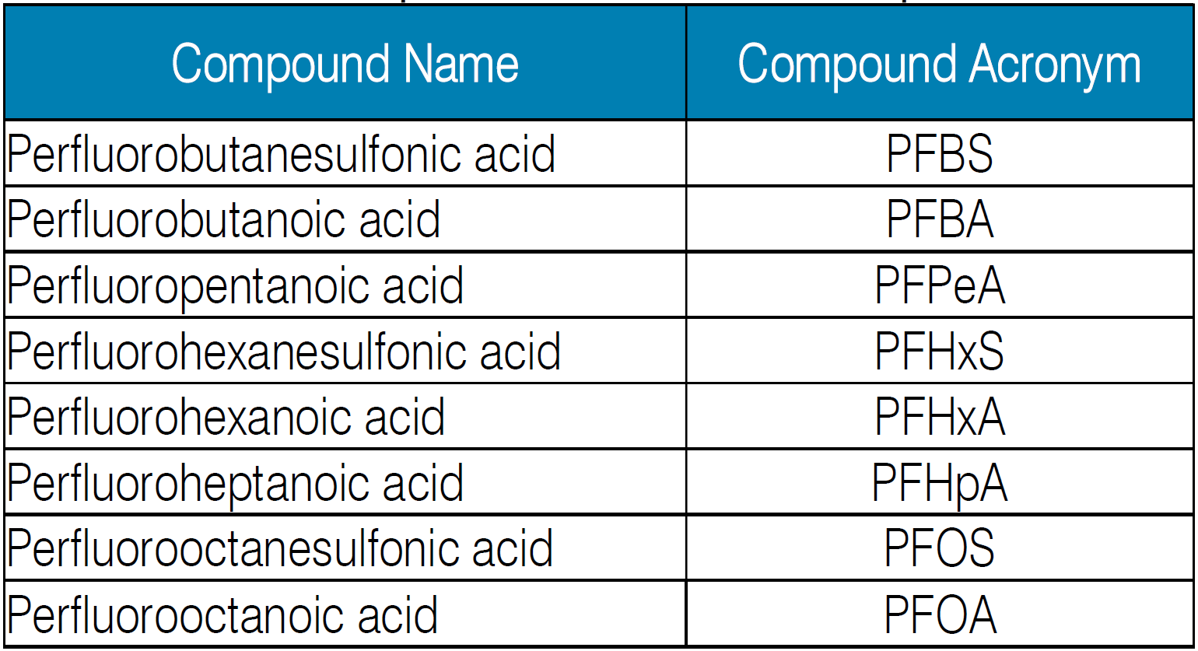
Per- and polyfluoroalkyl Substances (PFAS)
Weston & Sampson report now available for consultation on DEEP’s website
CTDEEP-WPCF-PFAS-Study-06_08_23-FINAL.pdf
Sampling program included:
Influent, effluent, sludge from 35 POTWs
Composite sludge and scrubber water at 4 sewage sludge incinerator facilities
Fish tissue near the outfalls of 10 POTWs, as well as surface water upgradient and downgradient of the outfalls
8 PFAS compounds were most prevalent. Detected in >50% of all samples taken across all media
4-8 carbon chain length compounds were the most frequently observed
Notes:
Red dots/stars indicates facilities where surface waters and fish tissue were sampled

Slide 22
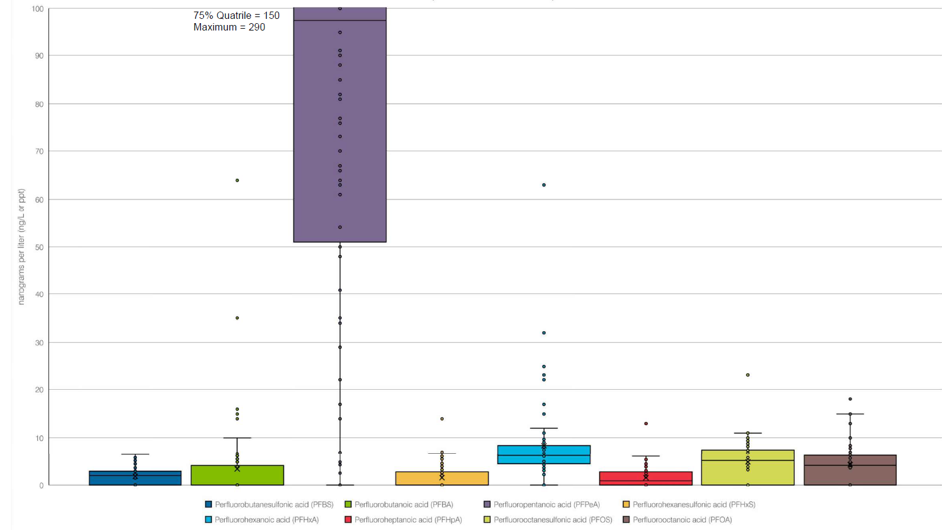
PFAS Study Results
Influent (PFPeA) (perfluoropentanoic acid, 5 carbon version of PFOA)
Effluent PFPeA and PFHxA
(5 and 6-carbon versions of PFOA) are the dominant PFAS found in effluent
Notes:
Influent (n=68): PFPeA (5-carbon version of PFOA) was the dominant PFAS compound found in WPCF influent, with an average concentration of 111 parts per trillion (ppt). [This
is approximately an order of magnitude greater than the remaining 7 of the 8 PFAS Reported in >50% of samples, which have averages ranging from 1.5 to 9 ng/L.]]
PFPeA and PFHxA were both detected in >90% of influent samples.
Effluent (n=69): PFPeA and PFHxA (5- and 6-carbon versions of PFOA) had the highest average concentrations in WPCF effluent. Average effluent concentrations were higher than average influent concentrations for 7 out of the 8 most prevalent PFAS compounds listed in the table above (all except PFPeA). Conversely, average concentrations of PFPeA decreased severalfold from influent to effluent. PFPeA, PFHxA, and PFOA were detected in >90% of effluent samples. [[Average concentrations of PFAS Reported in >50% of Samples in effluent range from 2.9 to 24 ng/L.]]

Slide 23
Most common parameters found in Surface waters
SLUDGE
PFOS is the dominant PFAS compound found in sludge. There were variances in types of PFAS identified in “solid” sludge vs “liquid” sludge
PFOS is the dominant PFAS compound found in composite incinerator sludge as well
PFHxA~70%
PFOS~70%

Slide 24
Stacy Pappano, Supervising Environmental Engineer

Slide 25
What’s next regarding PFAS GENERAL PFAS-related questions/concerns CAN BE ADDRESSED TO MEGHAN LALLY – DEEP.PFAS@ct.gov.
December 5, 2022 – EPA released new guidance recommending the implementation of quarterly PFAS monitoring at all POTWs, including those that do not receive industrial discharges.
CT DPH Environmental Laboratory Certification Program added draft method 1633 and method 1621, and an option for a modified method to the non-potable water ELCP scope
Draft Method 1633 - 40 PFAS parameters
According to EPA, draft method 1633 is expected to be fully approved for CWA soon.
Method 1621 – adsorbable organic fluorine
A circular to all environmental laboratories in April of 2023 and should have laboratories who apply for the additional methods certified by the end of 2023.

Slide 26
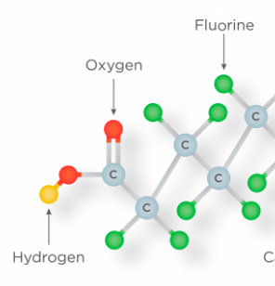
PFAS - monitoring implementation
DEEP Internal Workgroup
Coordinate efforts for source reduction and monitoring with Pretreatment Program
PFAS information and updates
General Permit Development
Monitoring requirements (influent, effluent, sludge)
Use EPA approved methods by CT DPH certified lab
Reporting sample results
How to collect monitoring results
How to manage the data collection

Slide 27
GENERAL PERMIT for Nitrogen Discharges
The renewal of the General Permit for Nitrogen Discharges authorizing the discharge of total nitrogen from specified (78) POTWs was public noticed in June 2023 and is pending final issuance.
The effective date is Jan 1, 2024 – Dec 31, 2028
A few updates regarding the pending renewal:
Reporting & Data Entry
Log into a system – IT developing this for launch in Jan 2024
Data entry in a new on-line fillable form
user subscriber agreements in development
no longer submitting a NAR excel spreadsheet template once system launches and agreements in place
Estimated timeframe for transition - early 2024
Nitrogen Monitoring
Nitrate and Nitrite will now be reported individually
Nitrogen Permit related questions/concerns –
ILIANA RAFFA Iliana.Raffa@ct.gov

Slide 28
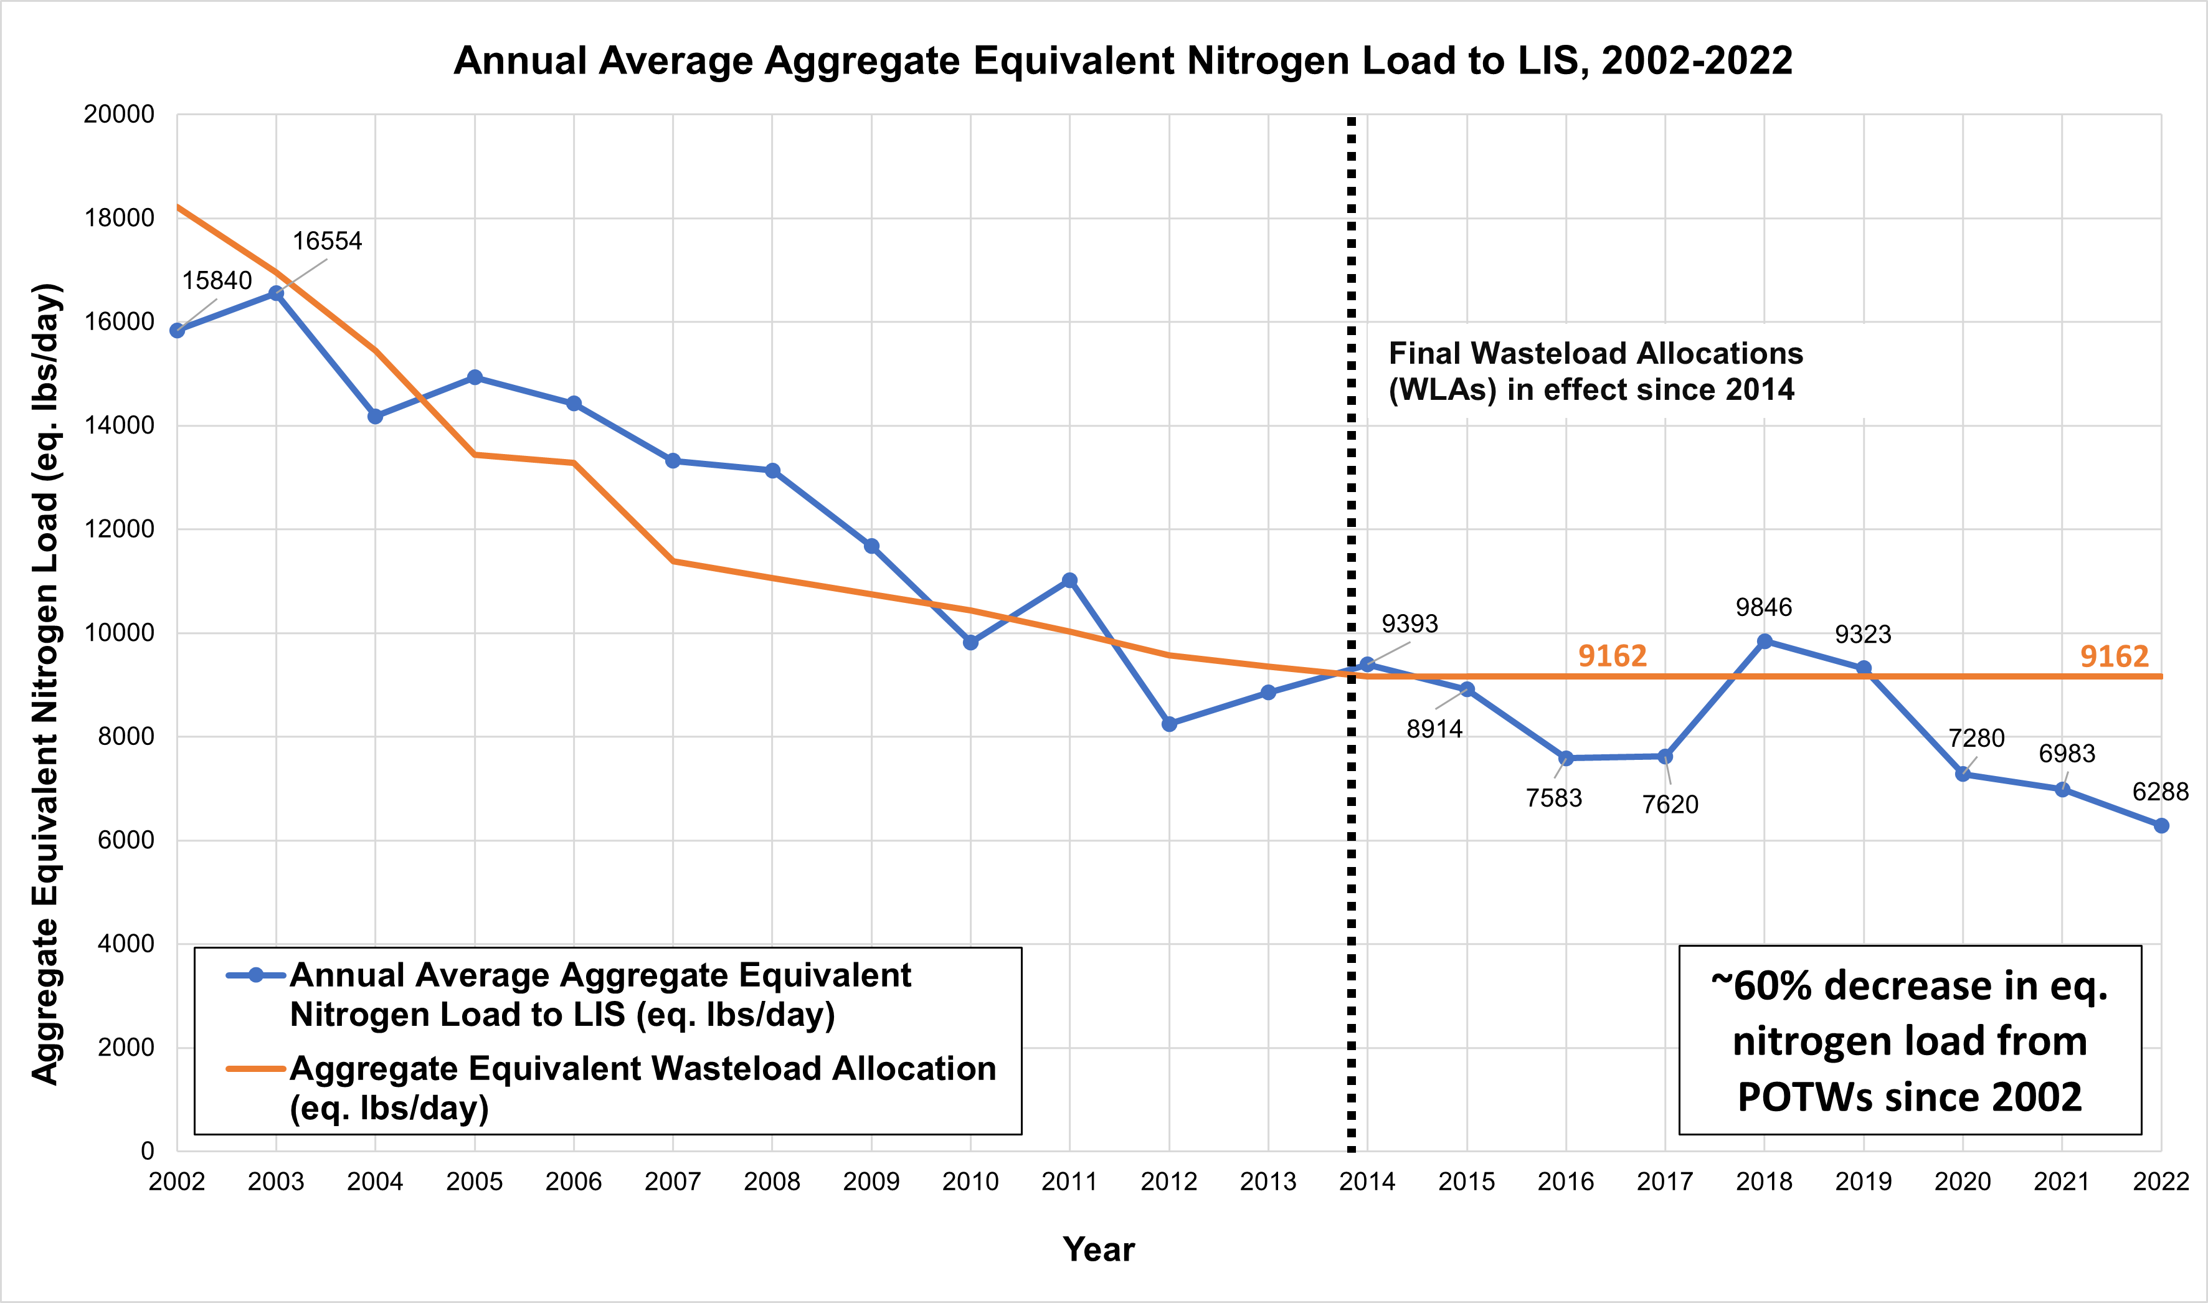
NITROGEN – LOADINGS AND COST OF CREDIT
Total Nitrogen: looking great for 2023 even though we have had unpredictable wet weather
Trend continues for loading reductions to Long Island Sound
Upgrade projects completed by 64 POTWs to enhance nitrogen removal out of 78 participating in the program
Compliance with the final TMDL limit (9,162 eq. lbs/day in effect starting in 2014) has been achieved in 6 out of 9 years
Record-low aggregate equivalent nitrogen loads in each of the last 3 years
Equivalent Nitrogen Load for the 2022 calendar year is 6,288 eq. lbs/day
$4.56 for buyers and a value of $0.50 for sellers for the calendar year 2022.

Slide 29
Nitrogen Operation & Maintenance Survey
The O&M Survey is sent out each year to collect information pertaining to capital costs, O&M costs, and effluent discharge which is used to develop the cost of the nitrogen trading credits.
DEEP will send the survey form by email the week of October 31st
Specific e-mail and contact will be noted in the instructions
Response due back to DEEP by December 15th
Only the 64 project facilities in the Nitrogen Trading Program receive the survey
Updates to the Survey Form:
Links and directions for inputs
Electric power provider
Sludge disposal destination

Slide 30
O&M Survey Form EXAMPLE:

Slide 31
npdes permits: Seasonal Phosphorus REPORTING
As the 2023 phosphorus treatment season wraps up, please remember how the average seasonal load cap should be calculated:
Convert all Total Phosphorus sample results from the season (April-October) from mg/l to lbs/day using the following equation:
$$Load \left(lbs/day\right)=Concentration \left(mg/l\right)×8.34×Total Flow on Day of Sampling (MGD)$$
Average together the loads calculated from all individual samples
DO NOT simply average together the 7 average monthly loads from April-October. All individual samples should be averaged.
DO NOT only report the average October load on the DMR. The seasonal load should be entered.
Contact person: Chris Falk - Christopher.falk@ct.gov

Slide 32
Operator certification contact person: Craig Motasky craig.Motasky@ct.gov
Computer based certification testing is ongoing and applications can be submitted at any time
Examinees who don’t pass the exam by the end of the 2023 will need to reapply to DEEP to begin retesting in 2024
The 2024 Exam Notice was posted on 10/1/23
Applications after 10/1/23 are for the 2024 calendar year and can begin testing on or after 1/2/24

Slide 33
Questions?

